Slide 1
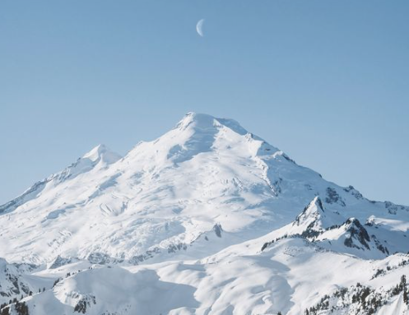
Snowfall in biathlon
World Cup places
February 2024 - Ironhack - Cyrielle Mary

Slide 2
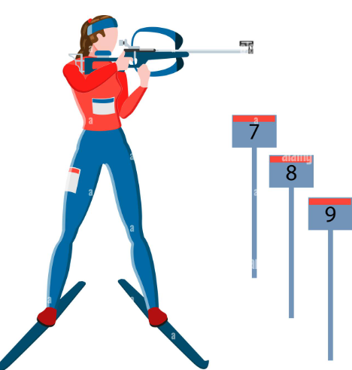


What is biathlon ?

Slide 3
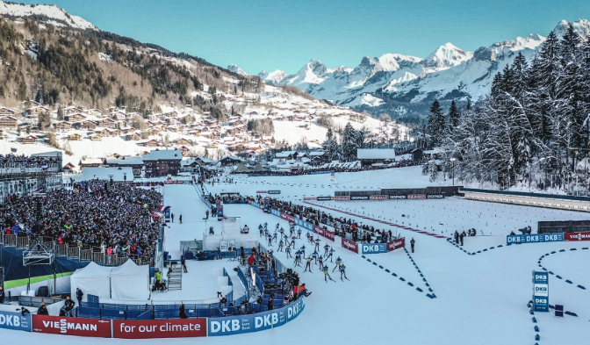
A biathlon stadium looks like this

Slide 4
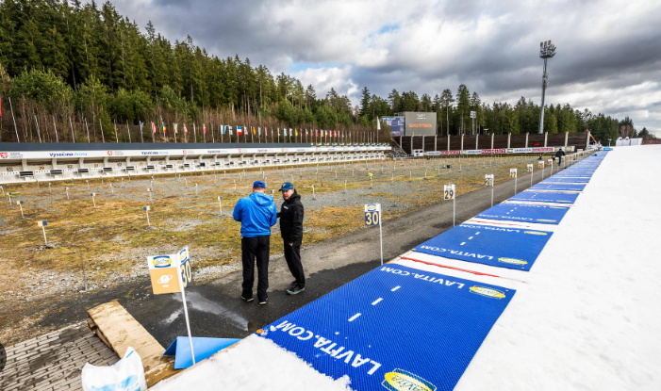
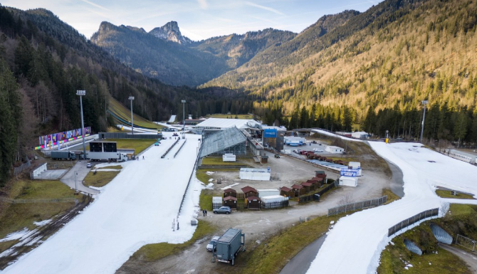
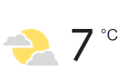
But also…

Slide 5
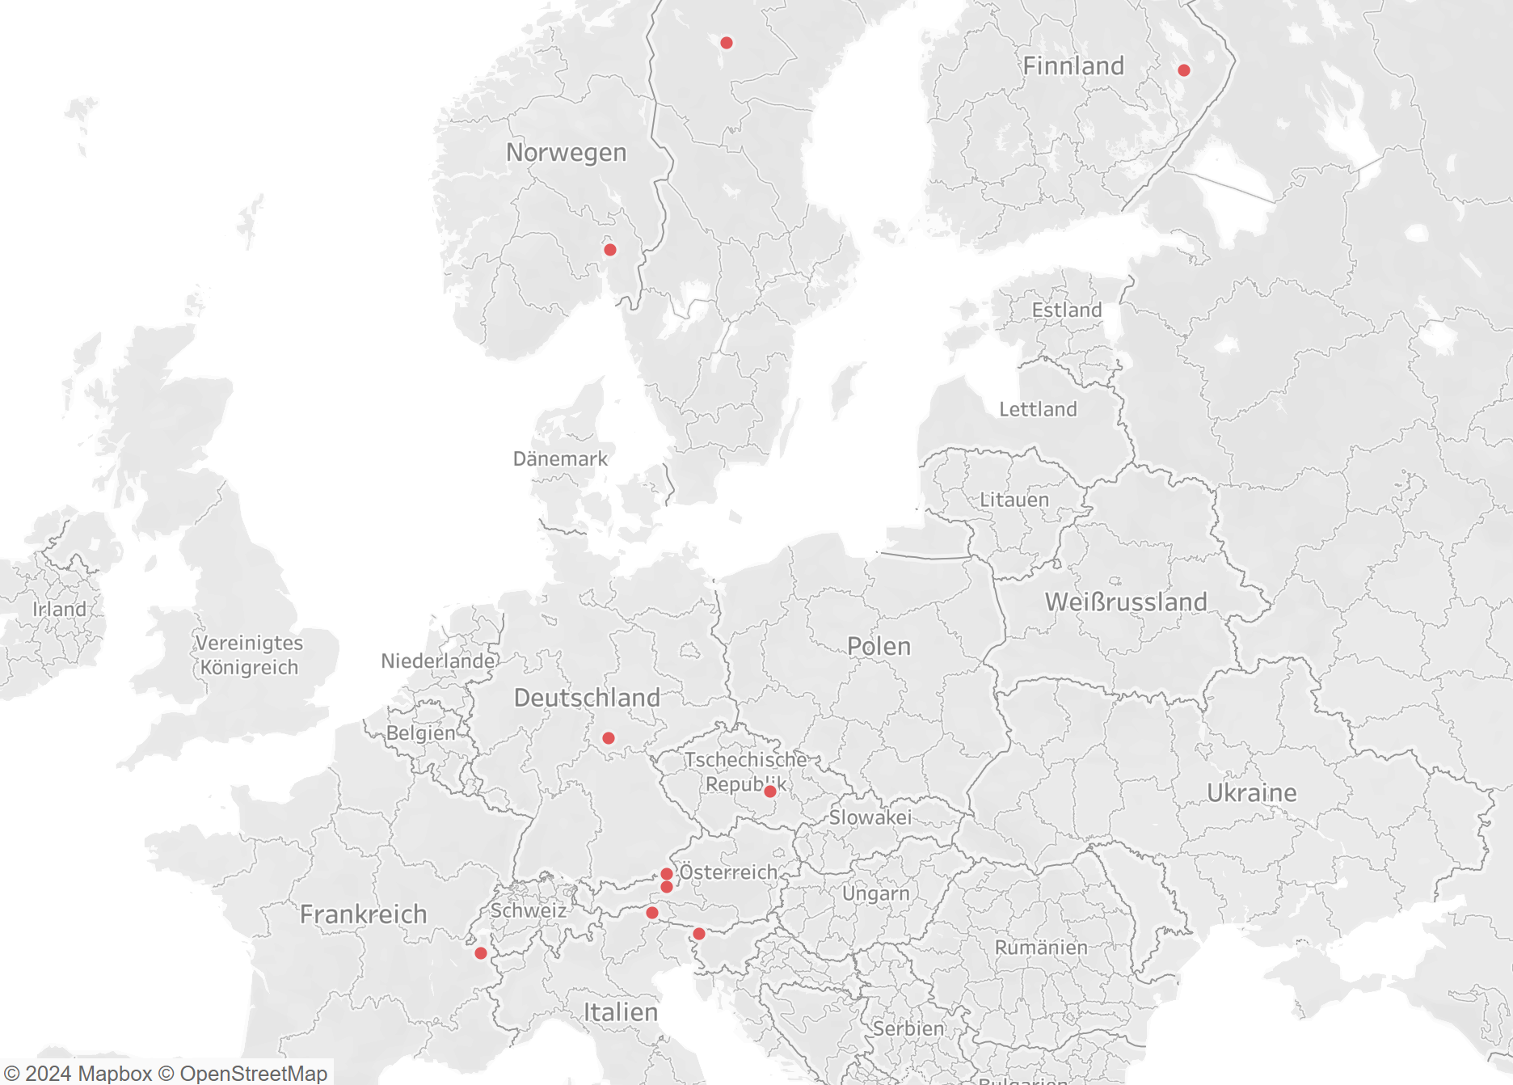

Slide 6
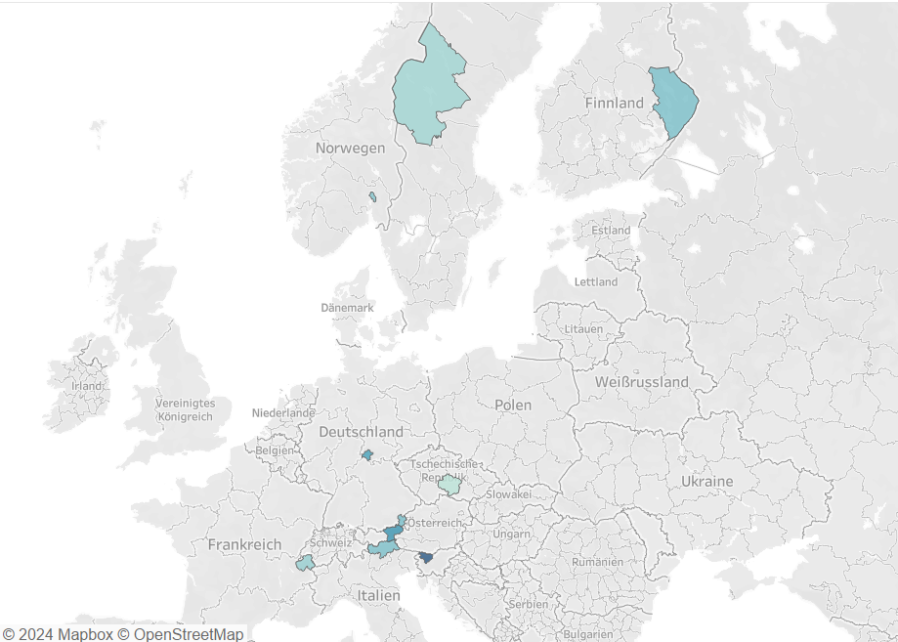
Density of snow

Slide 7
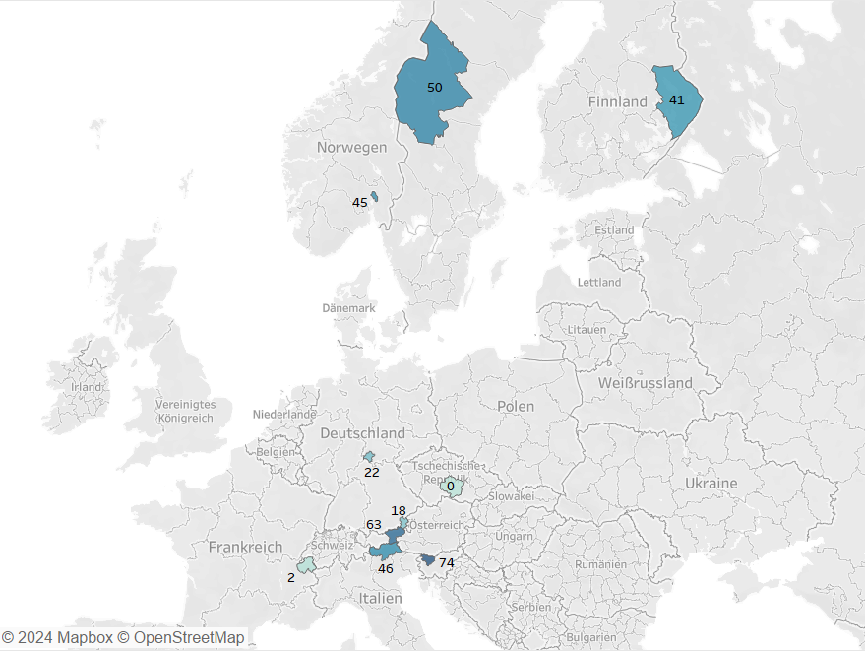
Number of days with >50cm snow per year

Slide 8
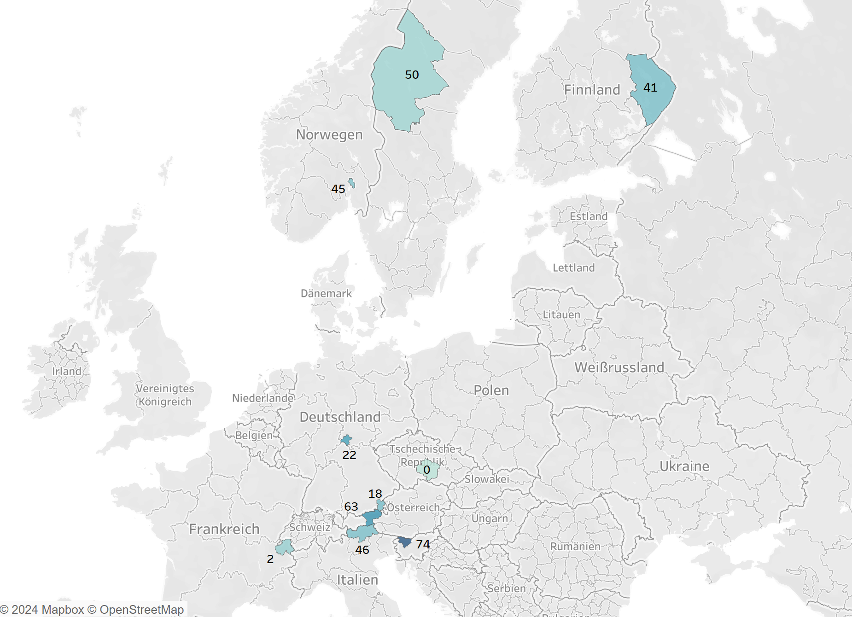
Density and
Days of snow >50cm

Slide 9
What is expected?
The season starts later
The season ends earlier
There is less amount of snow

Slide 10
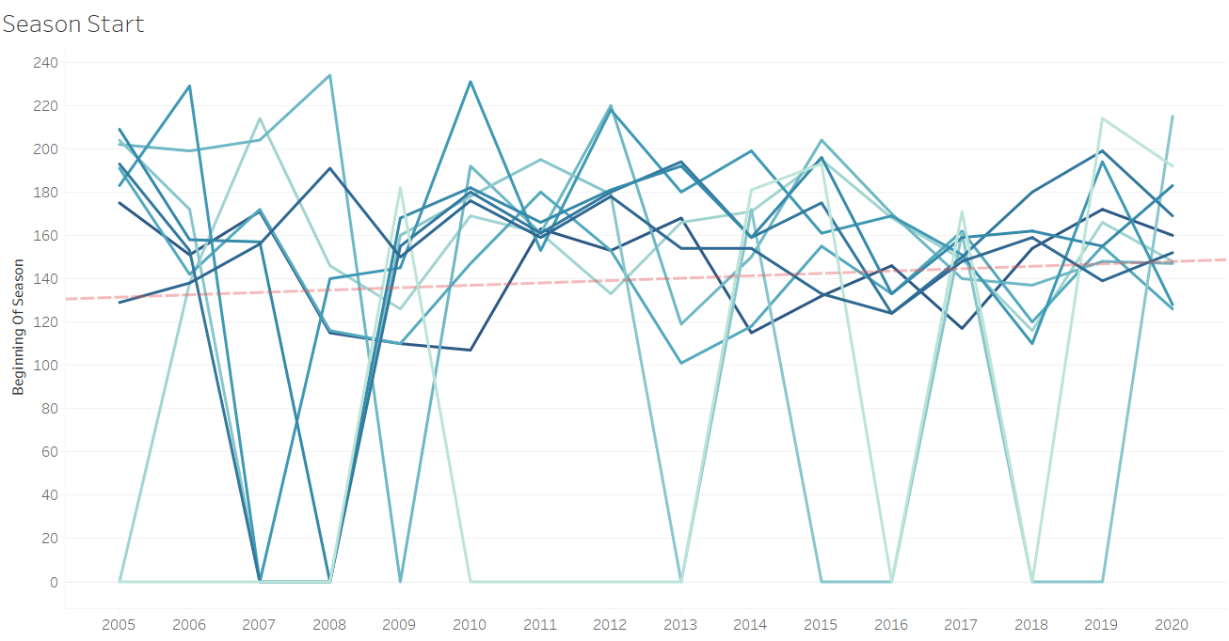
Notes:
130 = 9th of December

Slide 11
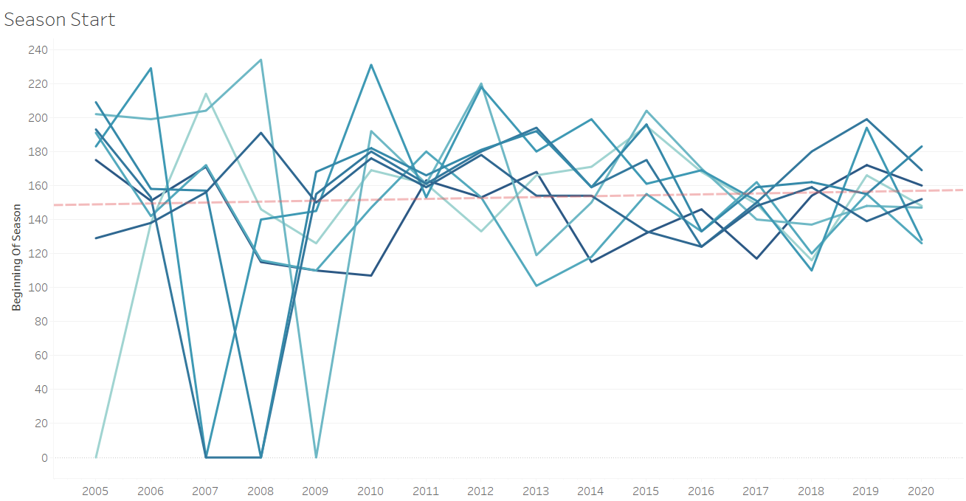
Notes:
150 = 29th of December

Slide 12
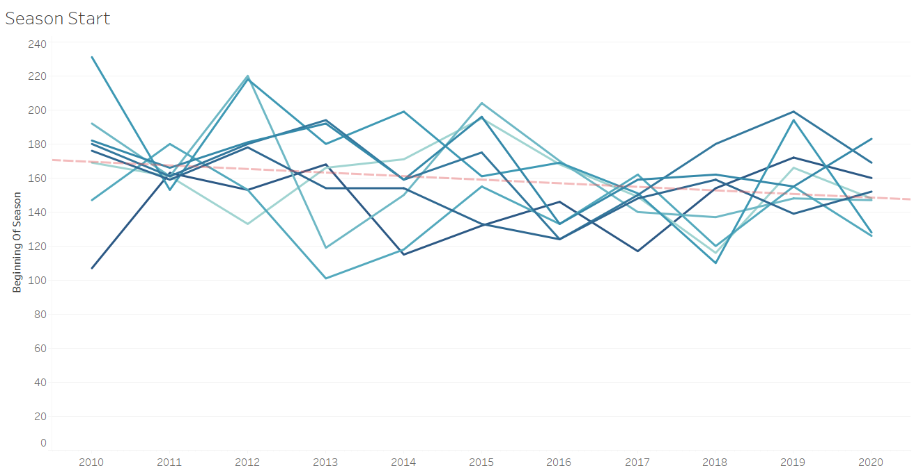
26/12
18/01
Notes:
170 = 18th of January

Slide 13
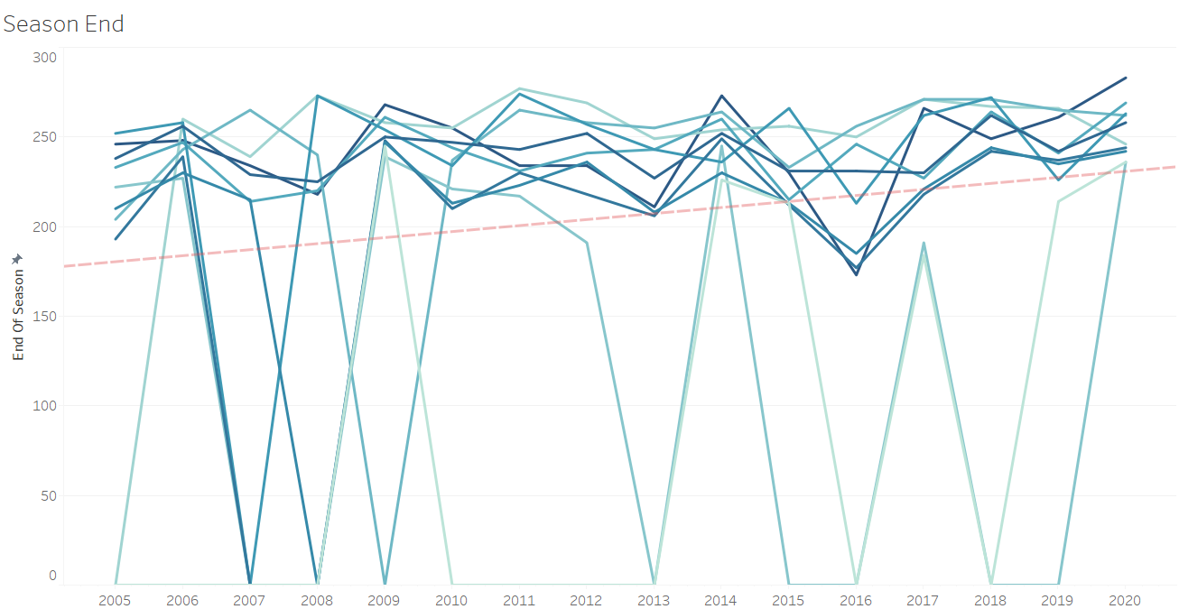
Notes:
200 = 17th of February

Slide 14

Notes:
200 = 17th of February // 250 = 8th of April

Slide 15
What is expected ?
The season starts later
The season ends earlier
There is less amount of snow

Slide 16
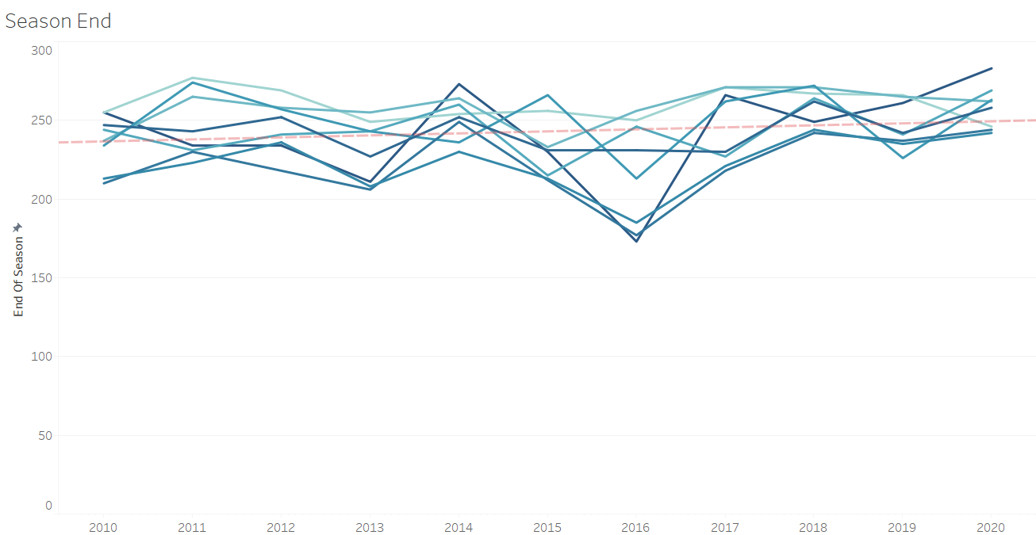
08/04
29/03
Notes:
240 = 29th of March // 250 = 8th of April

Slide 17
What is expected ?
The season starts later
The season ends earlier
There is less amount of snow

Slide 18
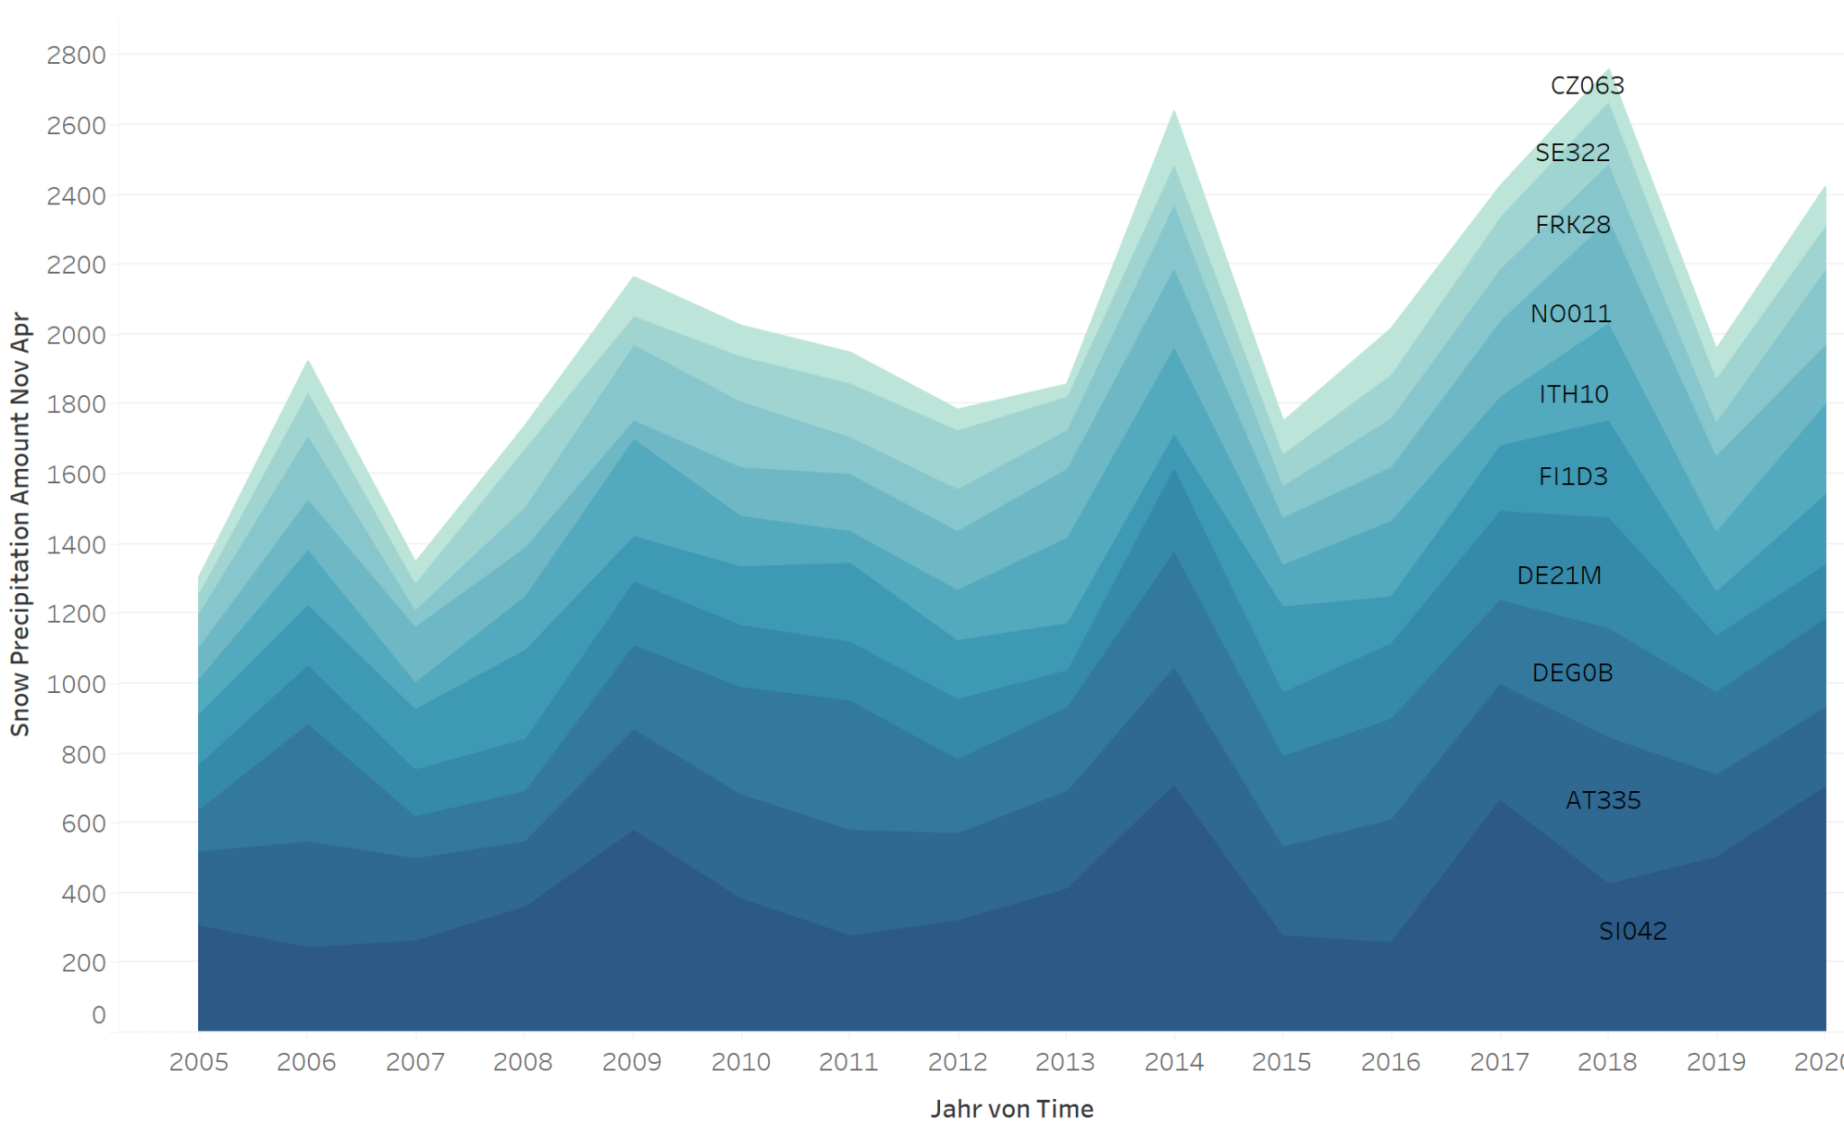

Slide 19
What is expected ?
The season starts later
The season ends earlier
There is less amount of snow

Slide 20
What about the temperature over those years?

Slide 21
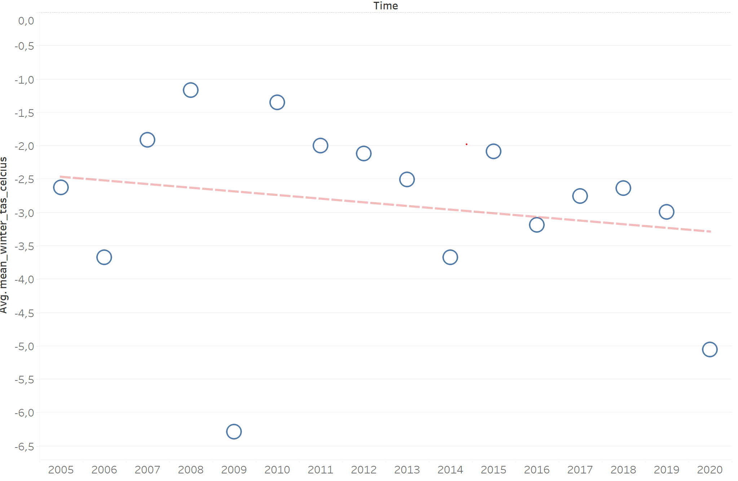
Evolution of average temperature (°C) during the winter

Slide 22
So far so good
Let’s have a closer look on France and Tcheque Republic

Slide 23
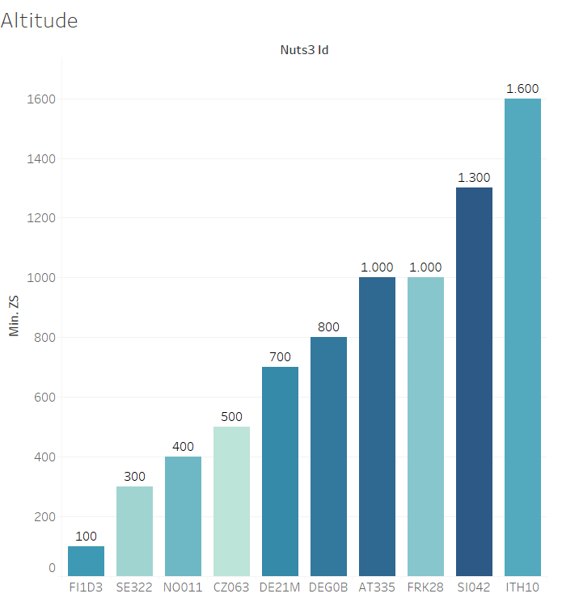

Slide 24
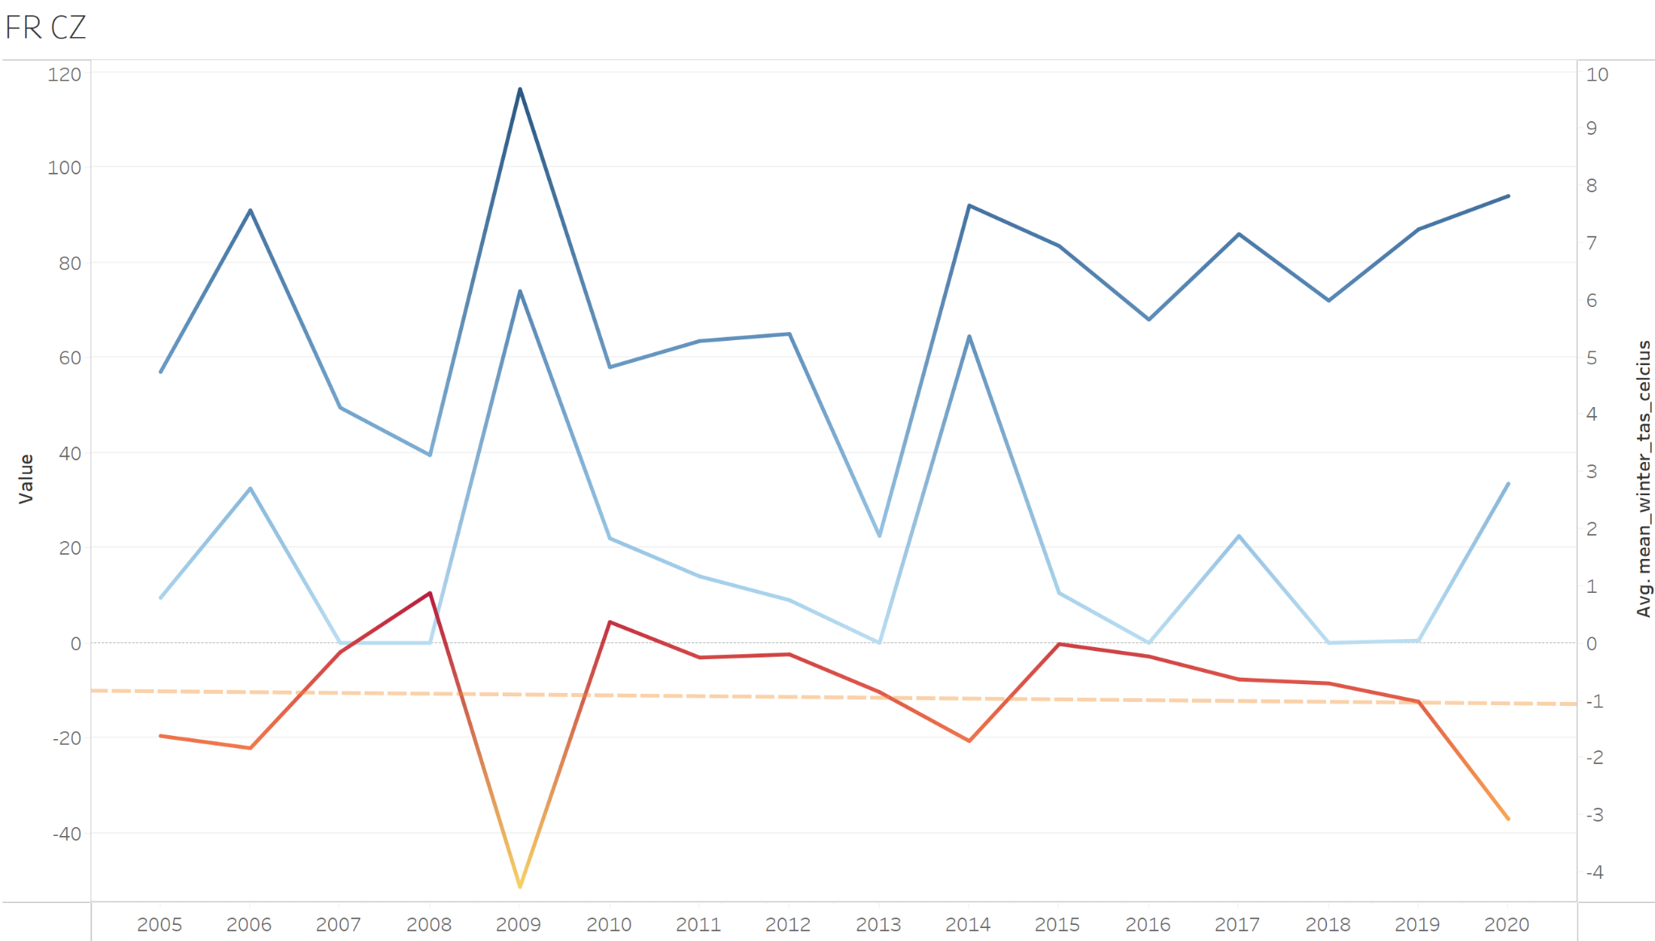



Slide 25
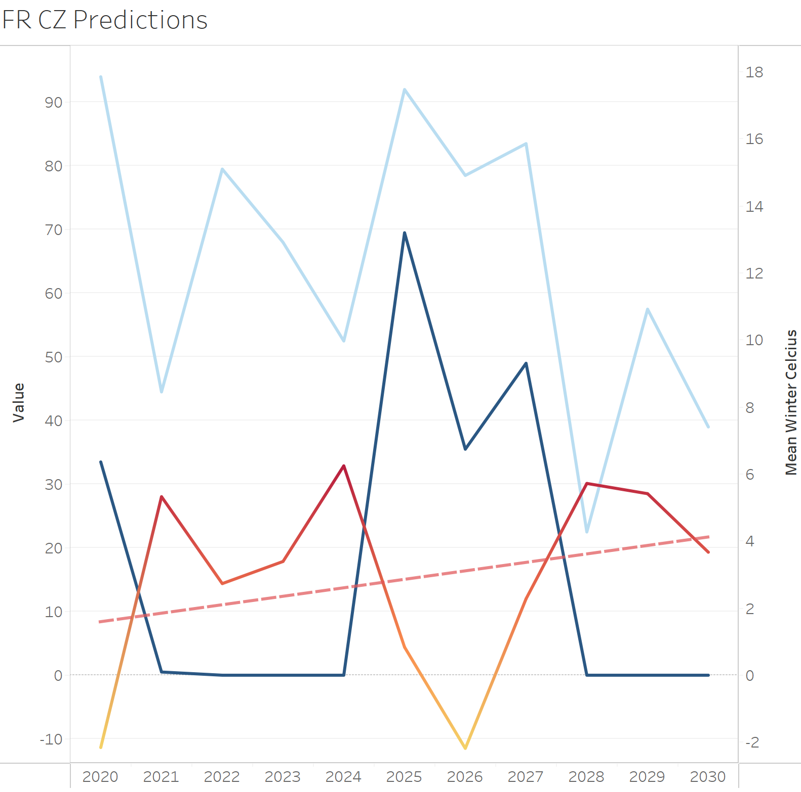
6°C
0 day

Slide 26
Conclusions
FR and CZ have less good conditions than the rest
Biased sample:
Places known for good weather conditions
Must not make conclusion over Europe

Slide 27
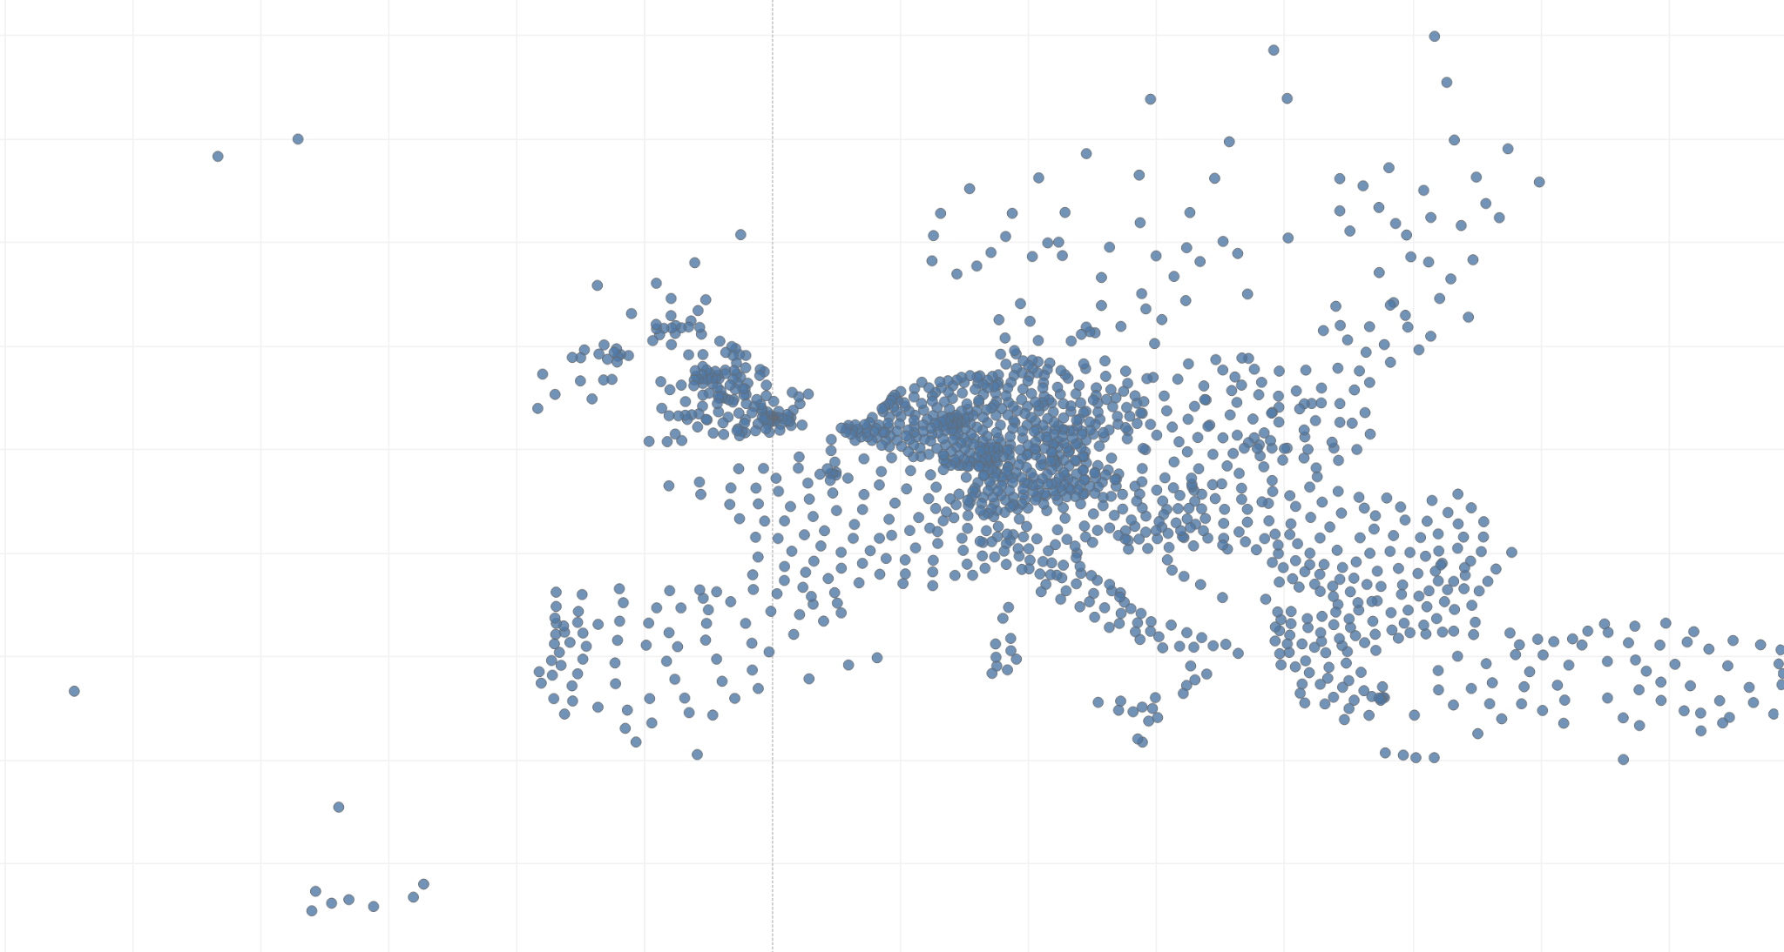

Slide 28
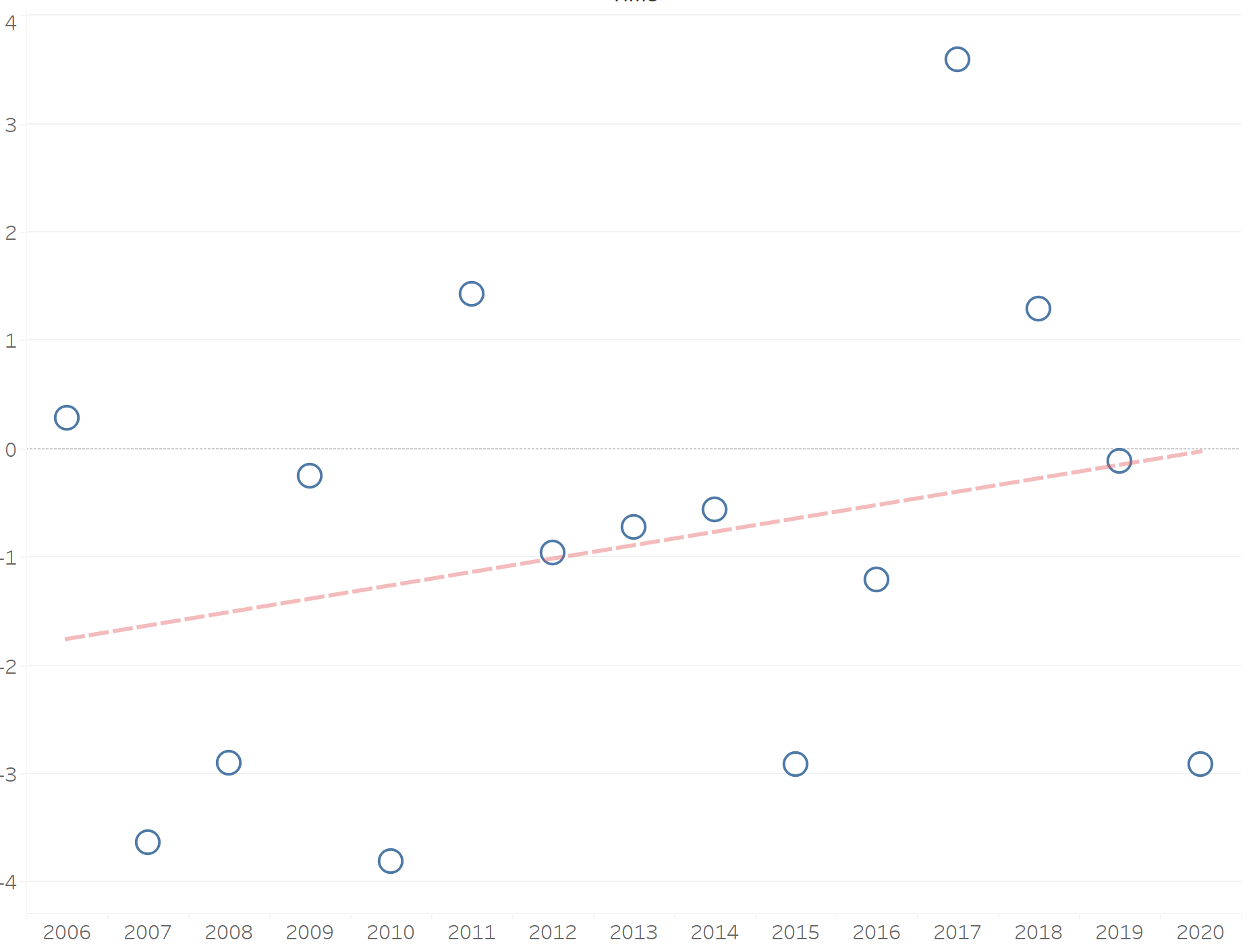
Almost + 2°C

Slide 29
Thank you

